Slide 1

FlyingWhale Airline - Data Analysis
By: Rafia Amir, Rian Qadir, Ramsha Noor, Nauman

Slide 2

Agenda
Introduction
Introduction to Datasets
Flight Activity Analysis
Loyalty Segmentation
Enrollment and Cancellation Trends
Key Recommendations
Conclusion

Slide 3

Introduction
Purpose of Analysis :
Enhance customer engagement
Optimize loyalty program effectiveness
Improve customer satisfaction during peak periods

Slide 4
Introduction to Datasets
Dataset 1: Customer Flight Activity
Loyalty Number, Flights Booked, Flights with Companions, Distance, Points Accumulated/Redeemed, Dollar Cost of Points Redeemed.
Dataset 2: Customer Loyalty History
Loyalty Number, Demographics, Loyalty Card Status, CLV, Enrollment, and Cancellation Details.

Slide 5
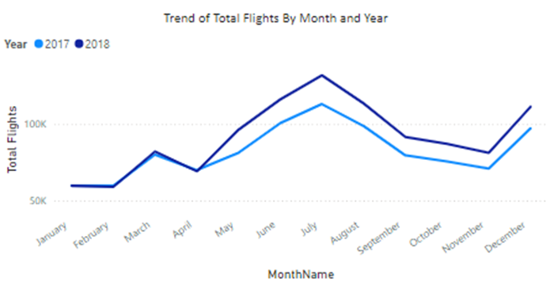
Flight Activity Analysis - Monthly & Yearly Booking Patterns
Key insight: Peak booking periods in July-September and December.
Hypothesis: Driven by school vacations and holidays.

Slide 6
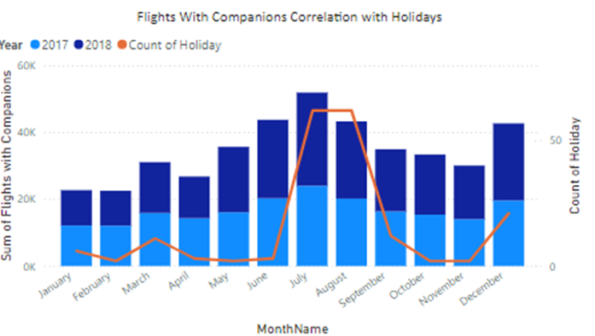
Flight Activity Analysis - Distance vs Loyalty Points
Key Insight: Clear positive correlation, with longer flights earning more points.

Slide 7
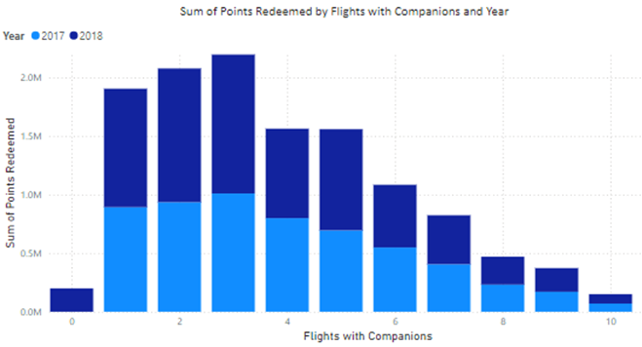
Flight Activity Analysis - Impact of Companion Bookings
Travelers with 3 companions redeem the most points.

Slide 8
Flight Activity Recommendations
Target marketing around peak periods (summer, holidays).
Special perks for companion bookings (family discounts, loyalty bonuses).
Encourage point redemption for solo travelers.

Slide 9
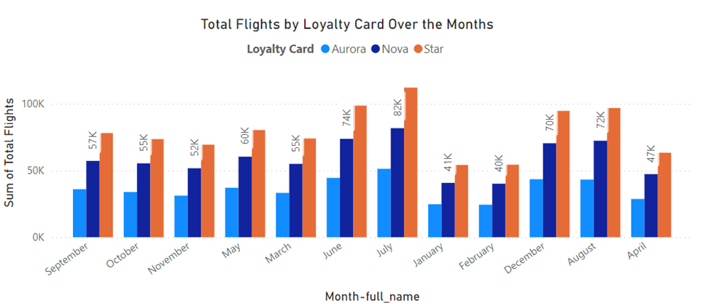
Loyalty Segmentation - Customer Segmentation
Breakdown of customer segments by Loyalty Card Status:
Star (Premium), Nova, Aurora
Most flights are booked by Star members.
Key demographic insight: 58% of loyalty cardholders are married.

Slide 10
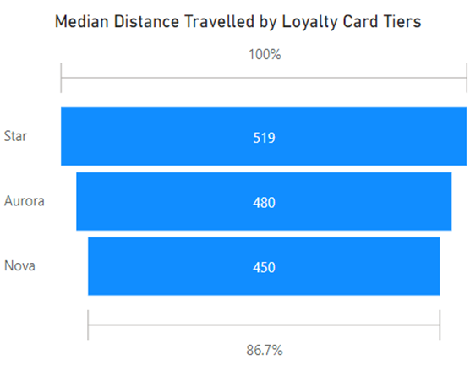
Loyalty Segmentation - CLV Across Loyalty Cards
Key Insight: Aurora cardholders, despite being in a lower tier, contribute the most to CLV.

Slide 11
Loyalty Segmentation Recommendations
Focus on Aurora cardholders for higher ROI.
Offer direct flight benefits and premium services to Aurora members to boost satisfaction.

Slide 12
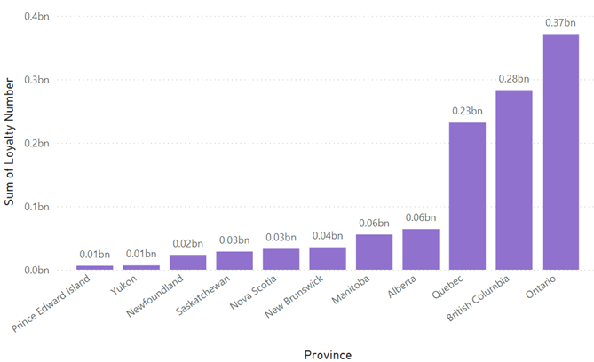
Enrollment & Cancellation Trends - Cancellations by Province
Key Insight: Prince Edward Island has the shortest enrollment duration, and Ontario has the highest cancellation rate.

Slide 13
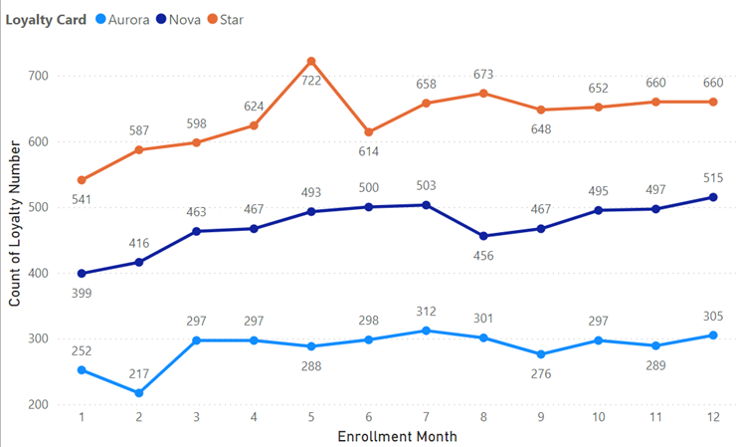
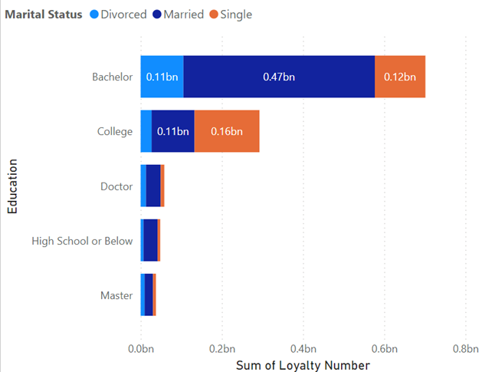
Enrollment & Cancellation Trends - Demographics & Time Trends
Key finding: Married bachelor's degree holders and single college-educated individuals cancel the most.
Peak cancellation months in August, November, and December.

Slide 14
Enrollment & Cancellation Recommendations
Targeted retention campaigns for high-cancellation provinces.
Tailored marketing for price-sensitive demographics (e.g., married bachelor’s degree holders).
Proactive customer engagement in peak cancellation months.

Slide 15
Conclusion
Align
Align marketing with peak travel periods.
Enhance
Enhance loyalty program for solo travelers and companion groups.
Implement
Implement targeted campaigns to reduce cancellations.
Drive
Drive long-term growth by improving customer experience and retention.

Slide 16

QUESTIONS?

Slide 17
THANKYOU

